Slide 1
Microsoft Power BI

Slide 2
Power BI Dev Camp – Session 1 Developing for Power BI with .NET Core
Ted Pattison
Principal Program Manager
Customer Advisory Team (CAT) at Microsoft

Slide 3
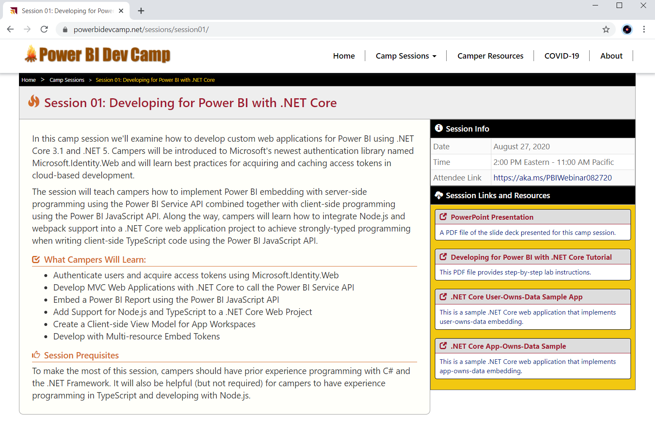
Welcome to Power BI Dev Camp
Power BI Dev Camp Portal - https://powerbidevcamp.net

Slide 4
Agenda
OAuth 2.0 and OpenID Connect
Microsoft Identity Platform 2.0
Developing with the Power BI .NET SDK
Developing with the App-Owns-Data Model
Developing Single Page Applications (SPAs)
Developing Secure Web Applications

Slide 5
Power BI Embedding – The Big Picture
User launches your app using a browser
App authenticates with Azure Active Directory and obtains access token
App uses access token to call to Power BI Service API
App retrieves data for embedded resource and passes it to browser.
Client-side code uses Power BI JavaScript API to create embedded resource
Embedded resource session created between browser and Power BI service
5
Power BI Service
Browser
iFrame
6
4
4
3
1
Your App
2
Azure AD

Slide 6
Choosing the Correct Embedding Model
User-Owns-Data Embedding
All users require a Power BI license
Useful in corporate environments
App authenticates as current user
Your code runs with user’s permissions
User’s access token passed to browser
App-Owns-Data Embedding
No users require Power BI license
Useful in commercial applications
App authenticates with app-only identity
Your code runs with admin permissions
Embed token passed to browser
User-Owns-Data Embedding for use within Organization
App-Owns-Data Embedding for use by ISVs
Browser
Power BI Service
Browser
Power BI Service
iFrame
iFrame
Azure AD
Access Token
Power BI
Embed Token

Slide 7
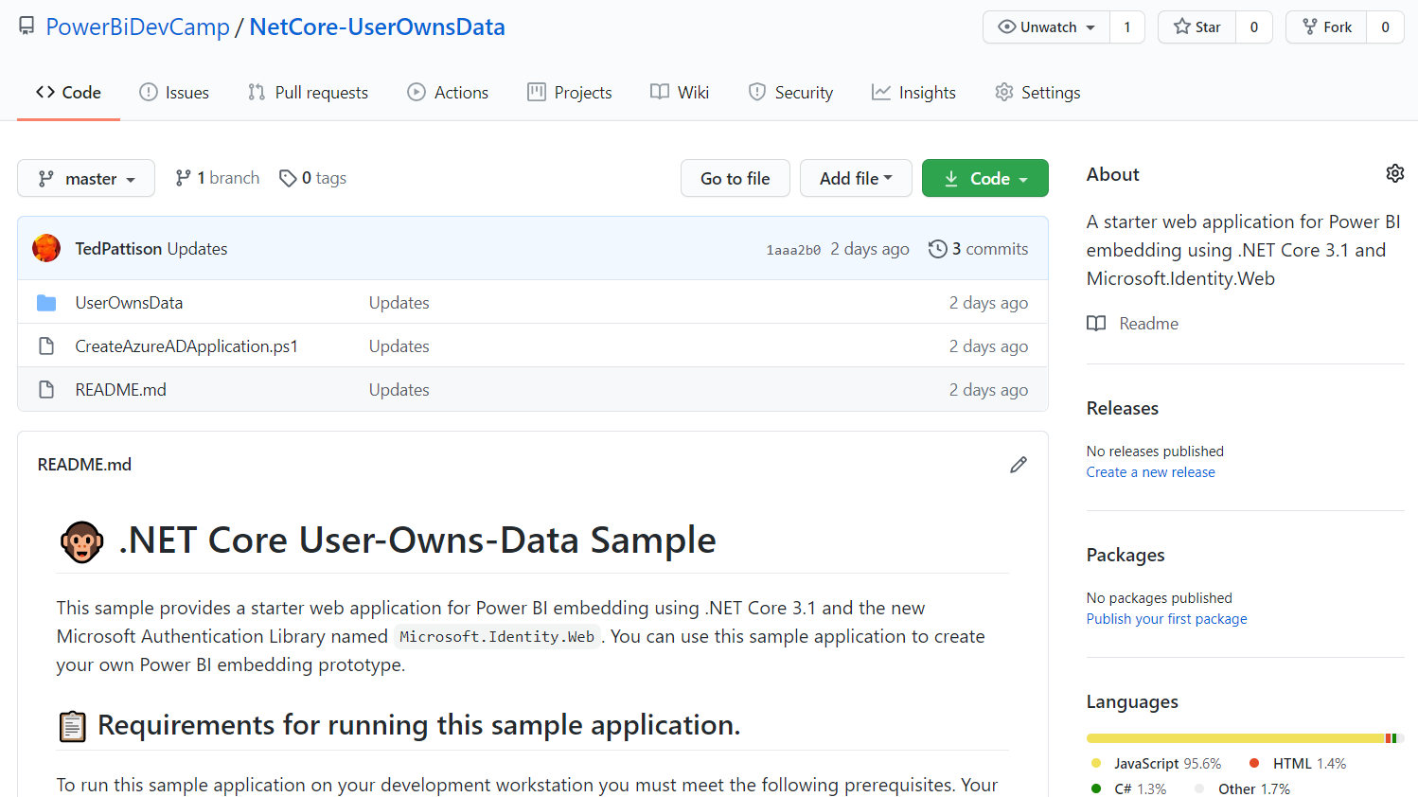
User-Owns-Data Sample Application
Stored in a GitHub repository for easy download
https://github.com/PowerBiDevCamp/NetCore-UserOwnsData

Slide 8
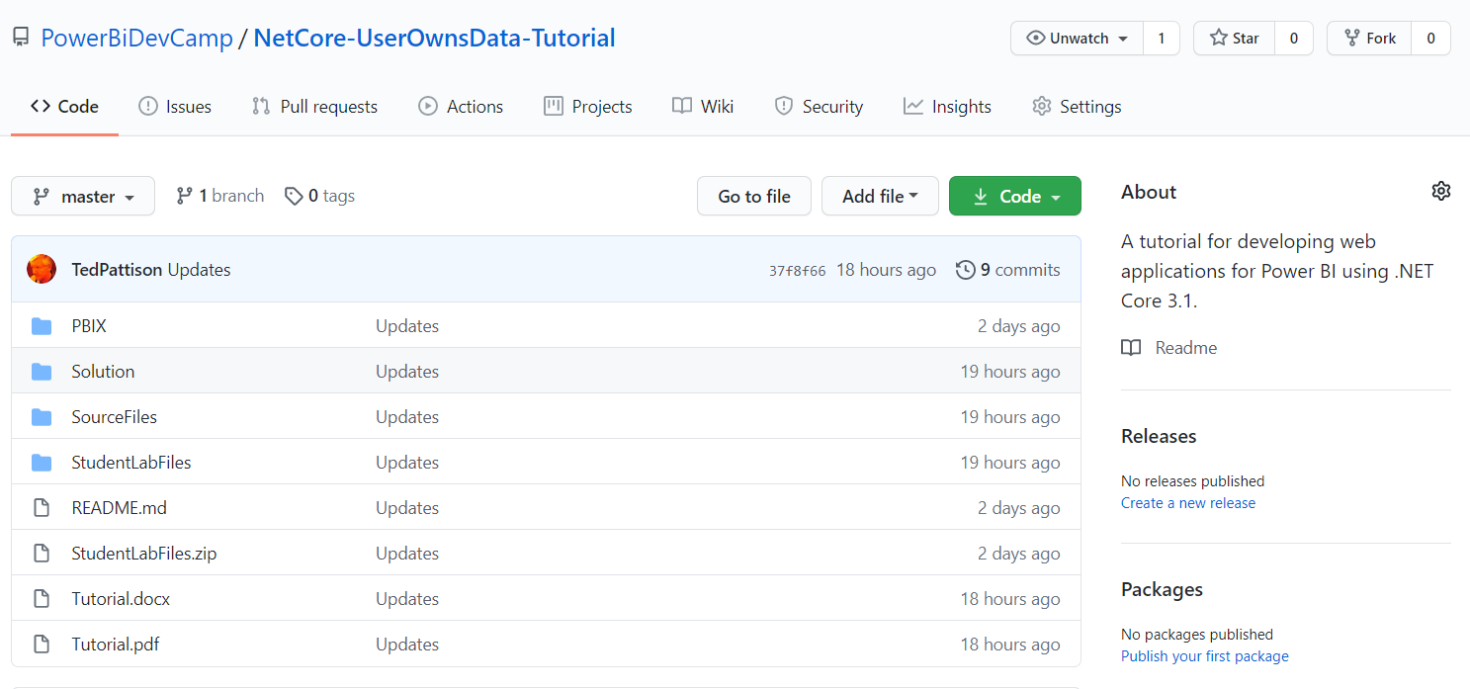
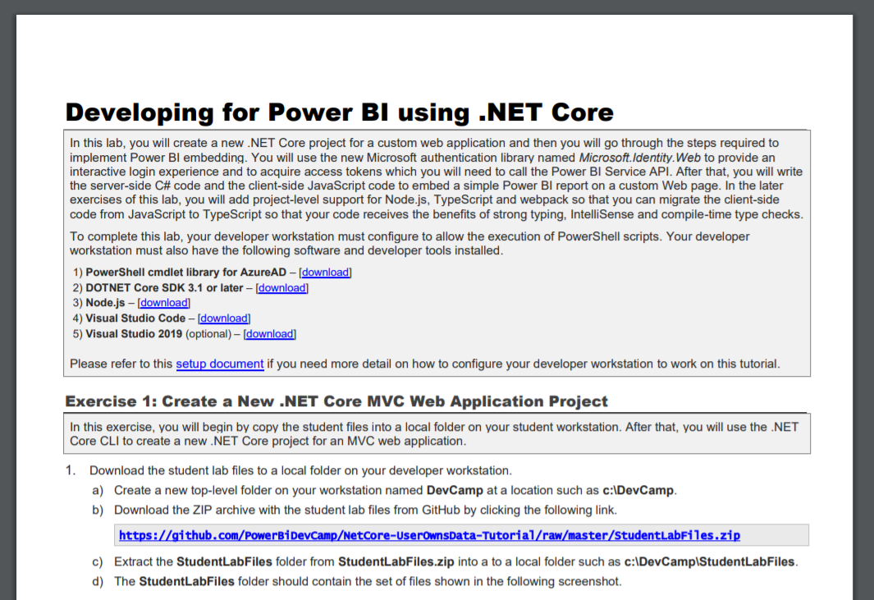
Tutorial: Developing for Power BI using .NET Core
https://github.com/PowerBiDevCamp/NetCore-UserOwnsData-Tutorial

Slide 9
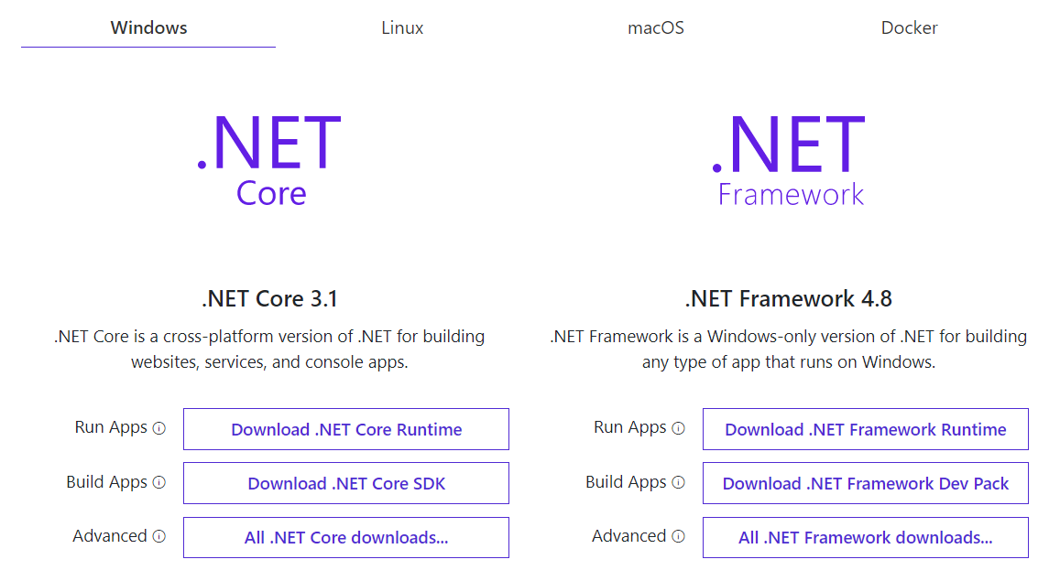
Install .NET Core SDK
https://dotnet.microsoft.com/download

Slide 10
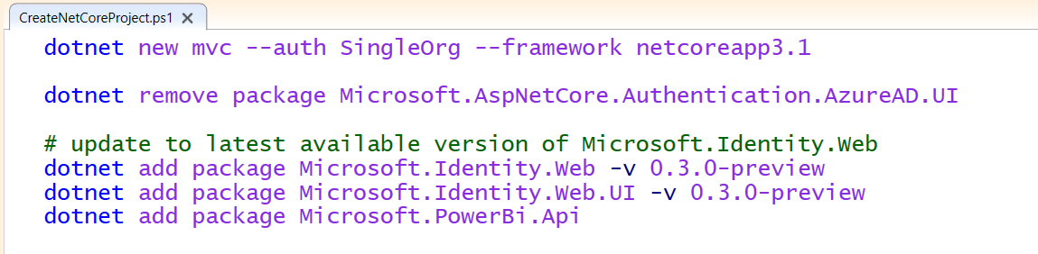
.NET Core CLI
The .NET Core command-line interface (CLI)
Cross-platform toolchain for creating, debugging and publishing applications
Create new applications using dotnet new command
Add NuGet packages using dotnet add package command

Slide 11
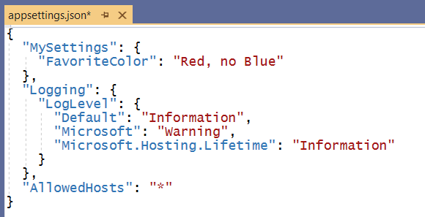
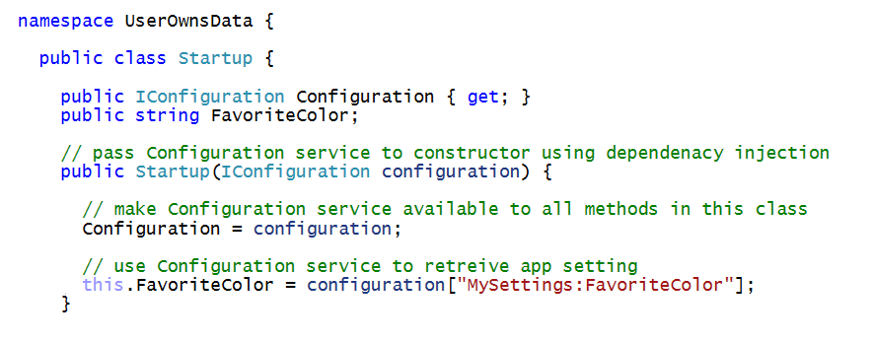
Understanding Dependency Injection is Essential
Services are registered on application start up
Services injected into classes using parameterized constructors
Dependency injection

Slide 12
Tutorial Exercise Flow
Exercise 1: Create a New .NET Core MVC Web Application Project
Exercise 2: Implement User Login using Microsoft.Identity.Web
Exercise 3: Call the Power BI Service API
Exercise 4: Embedding a Report using powerbi.js
Exercise 5: Adding TypeScript Support to a .NET Core Project
Exercise 6: Creating a View Model for App Workspaces

Slide 13
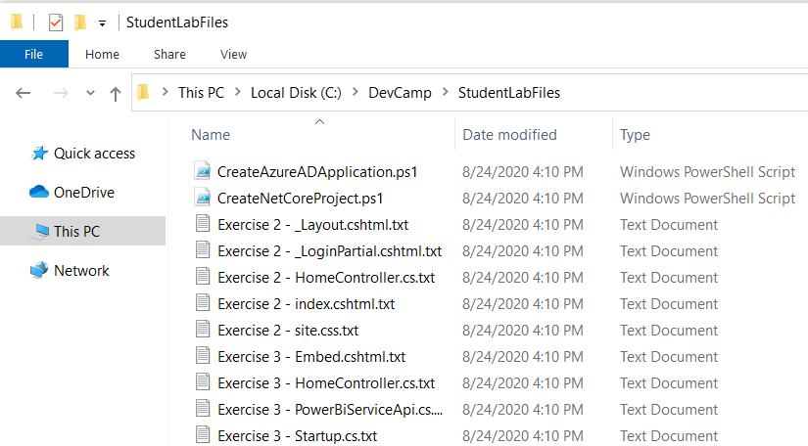
Copying-and-Pasting Code

Slide 14
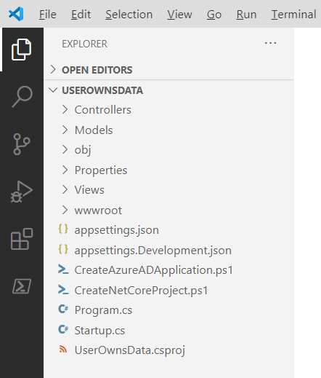
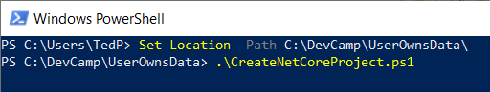
Exercise 1 Create a New .NET Core MVC Web Application Project

Slide 15
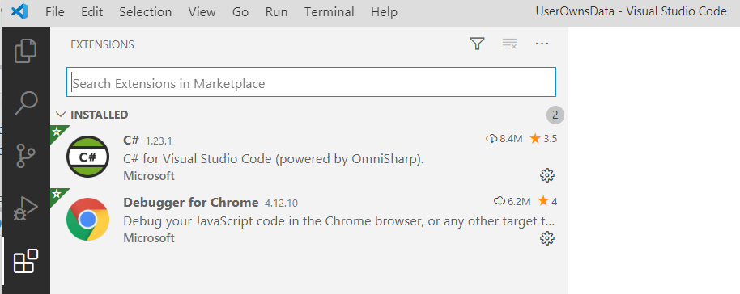
C# Extension for Visual Studio Code

Slide 16
Introducing Microsoft.Identity.Web
What is Microsoft.Identity.Web
Set of components and classes to assist developers
Used to perform authentication in Web applications and Web APIs
When to use
In Web application and Web APIs built on .NET Core 3.1 and .NET 5
Currently in preview – release schedule synced with .NET 5 (November 2020)

Slide 17
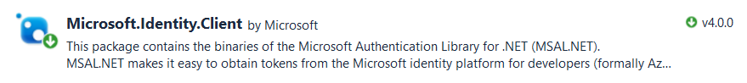
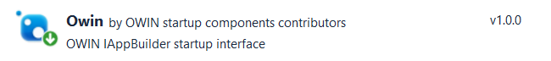
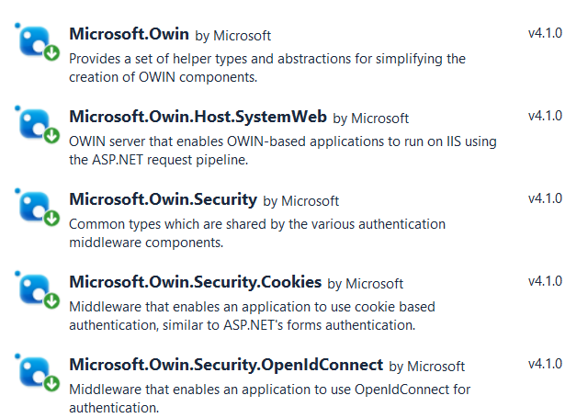
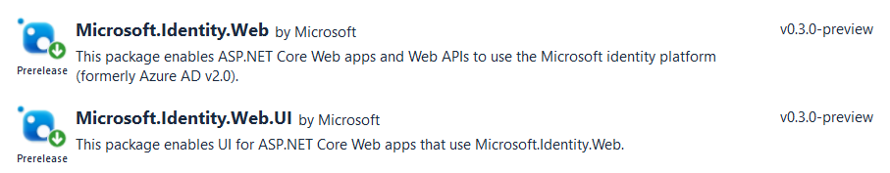
Microsoft Authentication Libraries
What did we do before Microsoft.Identity.Web?
Use Microsoft.Identity.Client (MSAL) to acquire and cache access tokens
Use OWIN Middleware components to implement OpenID connect
Microsoft.Identity.Web covers OpenID Connect and token acquisition

Slide 18
Exercise 2 Implement User Login using Microsoft.Identity.Web
Create a Confidential Client Application in Azure AD
Implement OpenID Connect using Microsoft.Identity.Web
Test Secured Routes in an ASP.NET Core Web Application

Slide 19
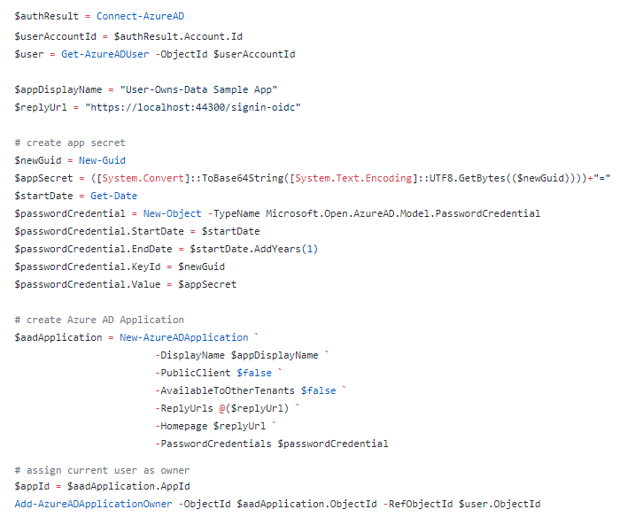
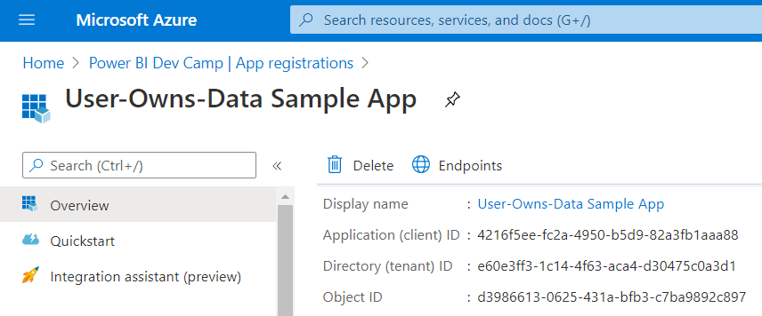
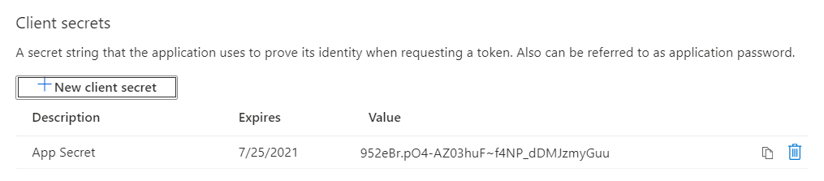
Creating Azure AD Application with PowerShell

Slide 20
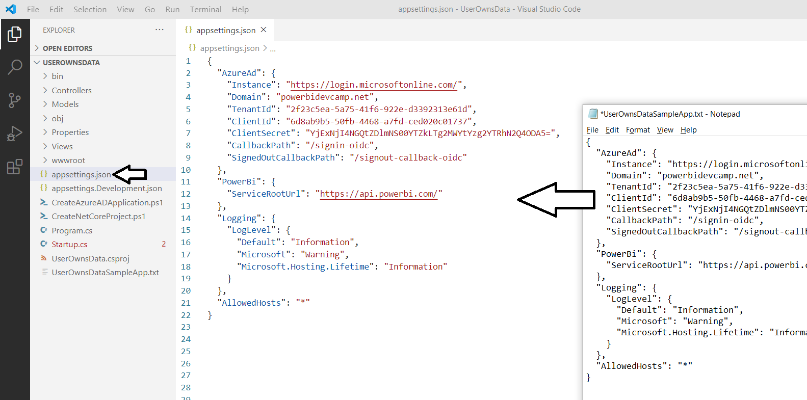
Azure AD Configuration in appsettings.json

Slide 21
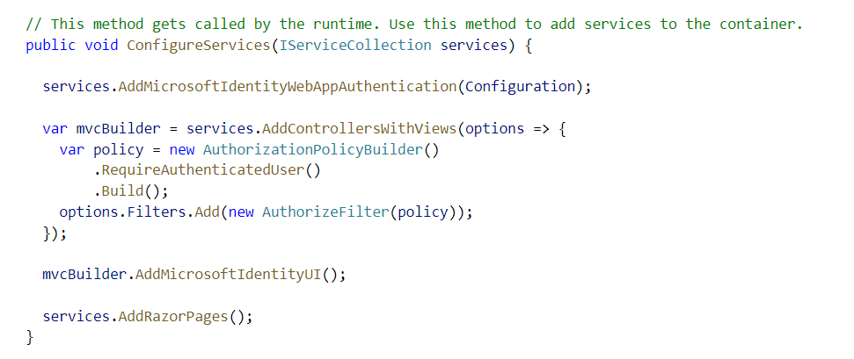
Enabling Authentication with Microsoft.Identity.Web

Slide 22
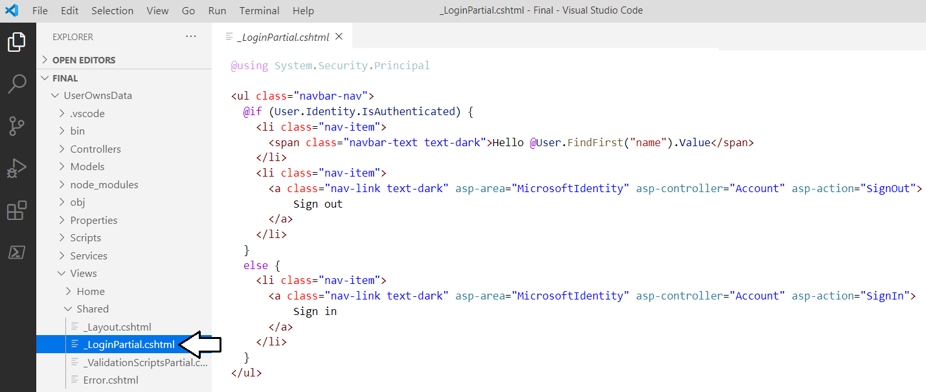
Adding Sign in / Sign Out Links

Slide 23
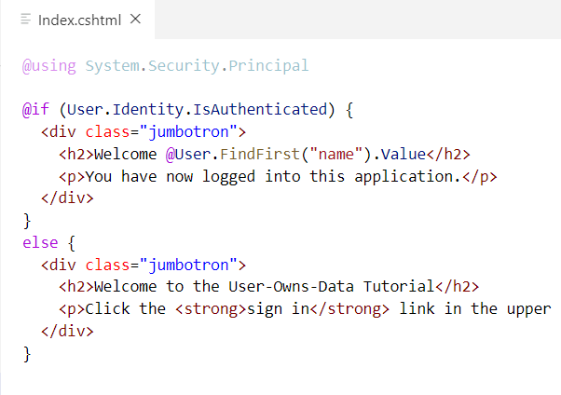
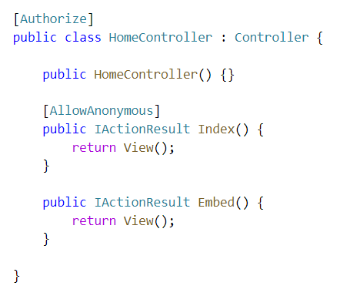
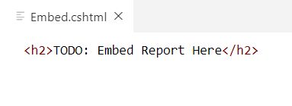
ASP.NET Supports Route Authorization
Routes with [AllowAnonymous] accessible to anonymous user
Routes secured with [Authorize] only accessible to authenticated users
Navigating to secured route automatically prompts for sign in
Index.cshtml
Embed.cshtml

Slide 24
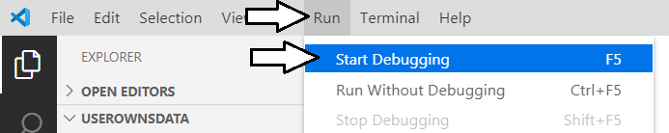
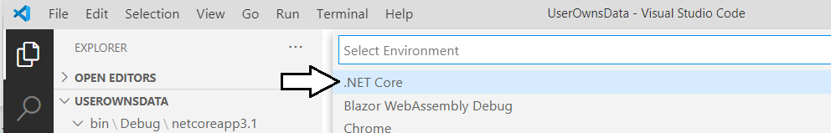
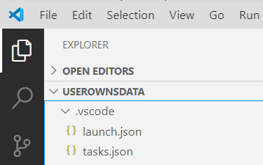
Starting a .NET Core Debugging Session

Slide 25
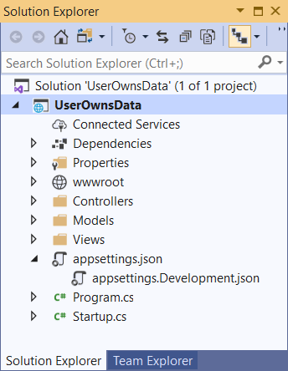
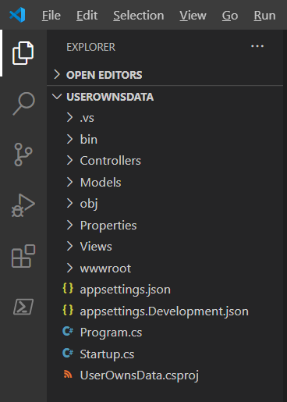
Visual Studio 2019 versus Visual Studio Code
Should you use Visual Studio 2019 versus Visual Studio Code?
Yes, either one can be used to develop for .NET Core 3.1 and .NET 5

Slide 26
What Is the Power BI Service API?
What is the Power BI Service API?
API built on OAuth2, OpenID Connect, REST and ODATA
API secured by Azure Active Directory (AAD)
API to program with workspaces, datasets, reports & dashboards
API also often called “Power BI REST API”
What can you do with the Power BI Service API?
Publish PBIX project files
Update connection details and datasource credentials
Create workspaces and clone content across workspaces
Embed Power BI reports and dashboards tiles in web pages
Create streaming datasets in order to build real-time dashboards

Slide 27
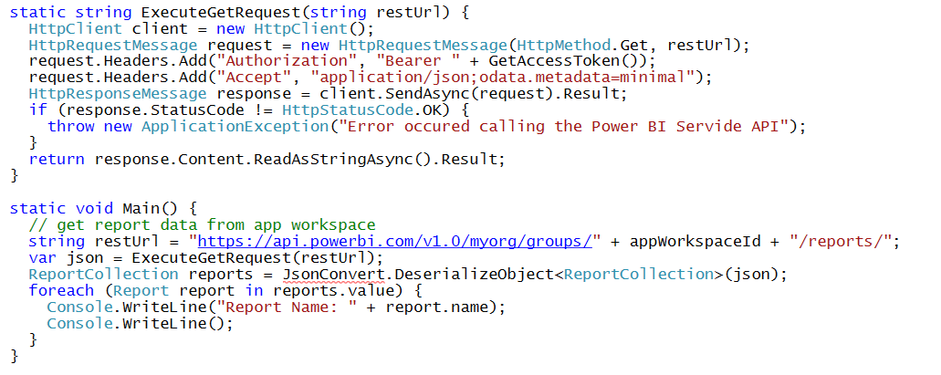
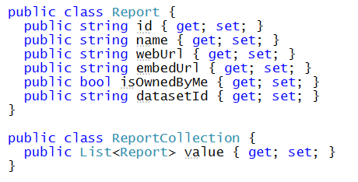
Calling the Power BI Service API Direct REST calls without using the Power BI .NET SDK
Your C# Code
Power BI
Service API
Executing HTTP Requests
Capturing HTTP Responses
Serializing/Deserializing JSON

Slide 28
Power BI .NET SDK
Developing without the Power BI .NET SDK
Developing with the Power BI .NET SDK
Your C# Code
Power BI
Service API
Executing HTTP Requests
Capturing HTTP Responses
Serializing/Deserializing JSON
Your C# Code
Power BI
Service API
Power BI .NET SDK
Executing HTTP Requests
Capturing HTTP Responses
Serializing/Deserializing JSON

Slide 29
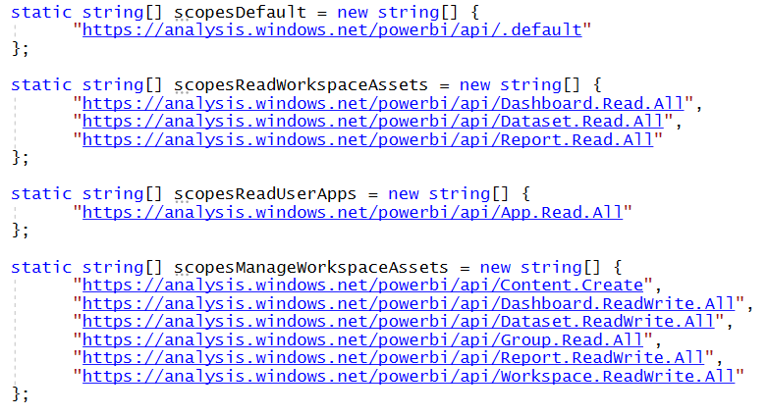
Power BI Service API Scopes
Azure AD V2 endpoint requires passing scopes
Scopes define permissions required in access token
Scopes defined as resource + permission https://analysis.windows.net/powerbi/api/ + Report.ReadWrite.All

Slide 30
Exercise 3 Call the Power BI Service API
sddddd

Slide 31
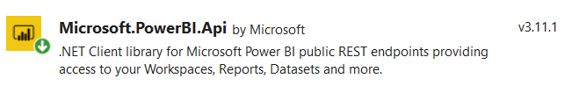
Migrating to v3 of the Power BI .NET SDK
You must move to SDK v3 to take advantage of latest API features
Automated server-side generation of PDF file from Power BI report
Advanced generation of embed tokens
Beware of breaking changes when moving from v2.x to 3.x
Namespace Microsoft.PowerBI.Api.v2 renamed to Microsoft.PowerBI.Api
Namespace Microsoft.PowerBI.Api.Models.v2 renamed to Microsoft.PowerBI.Api.Models
Parameters for Power BI resource IDs now based on GUIDs instead of strings

Slide 32
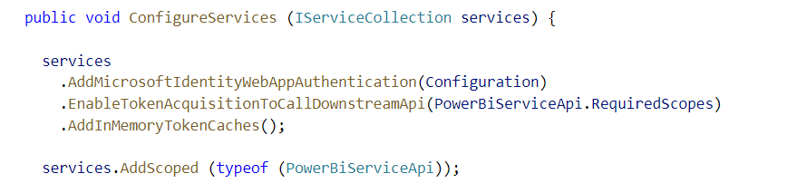
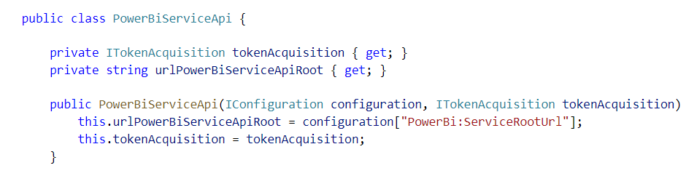
Adding Support for Token Acquisition
Modify ConfigureService in Startup.cs
Add a new C# Class named PowerBiServiceAPi
Dependency injection

Slide 33
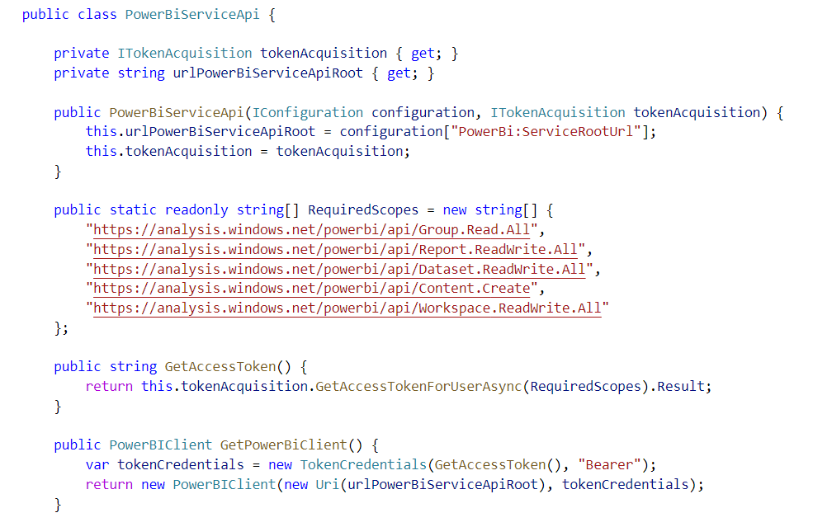
Adding Support for Acquiring Access Tokens

Slide 34
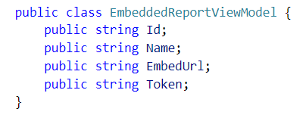
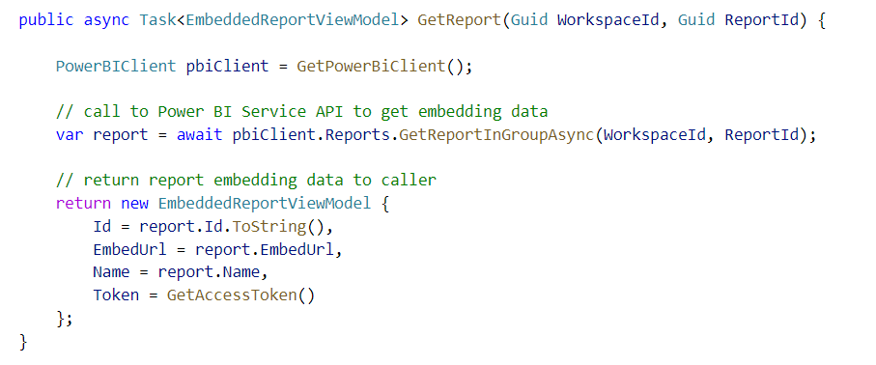
Call GetReportInGroupAsync to Get Embedding Data

Slide 35
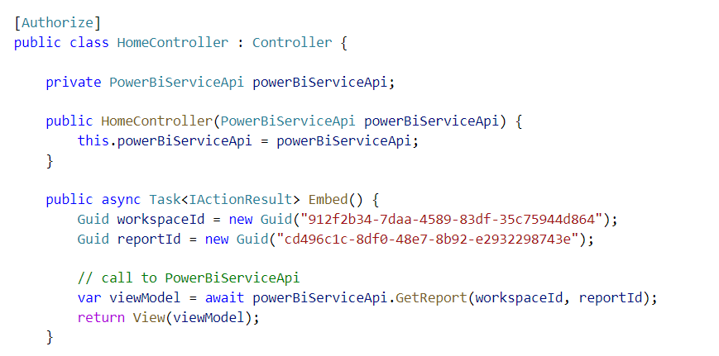
Accessing PowerBiServiceApi from a Controller
Dependency injection
MSAL Token Acquisition Service
PowerBiServiceAPI
HomeController
Dependency Injection
Dependency Injection

Slide 36
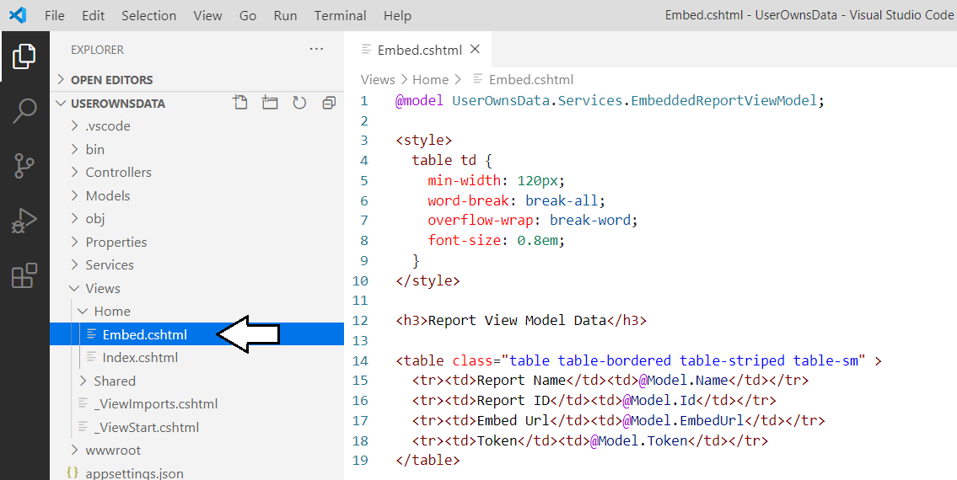
Displaying Data from the View Model

Slide 37
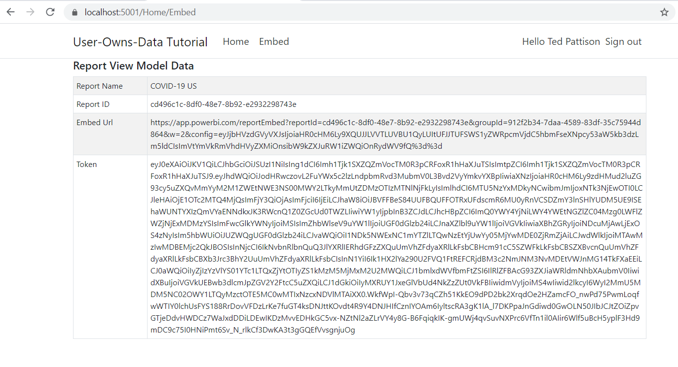
Exercise 3 Finale

Slide 38
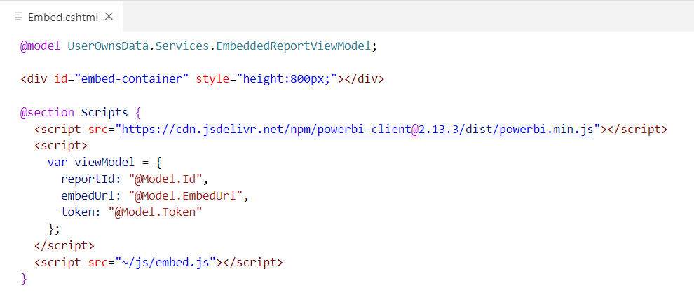
Exercise 4 Embedding a Report using powerbi.js

Slide 39
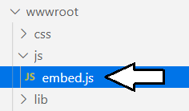
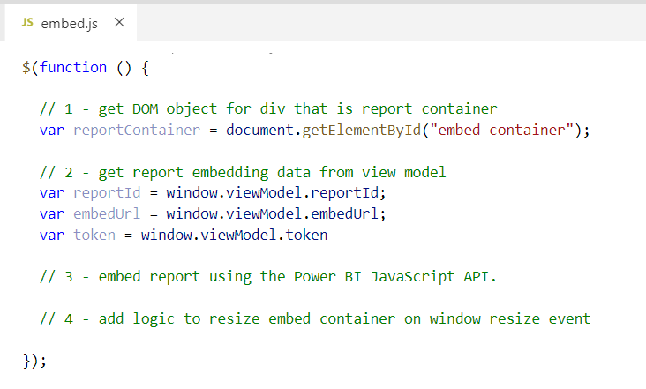
Retrieving Data from the Report View Model

Slide 40
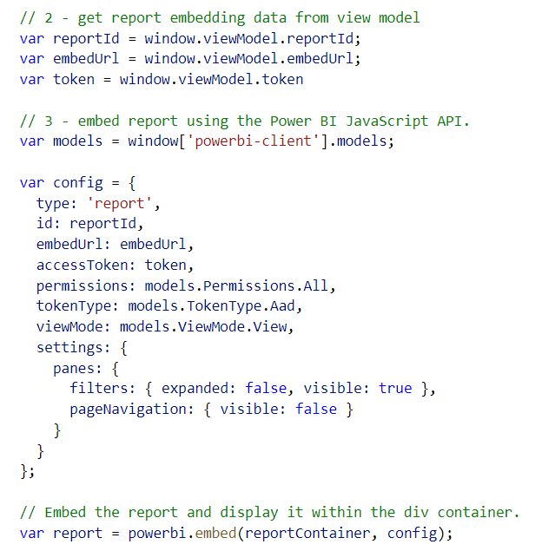
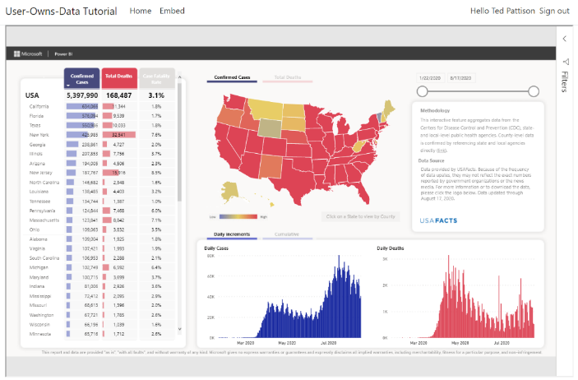
Embedding a Report using powerbi.js

Slide 41
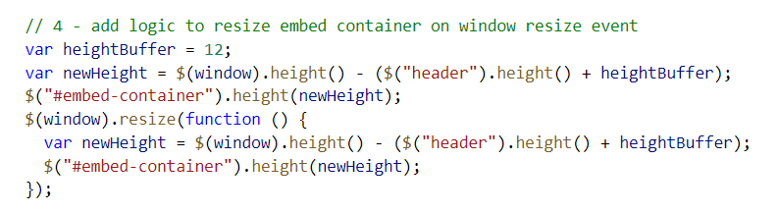
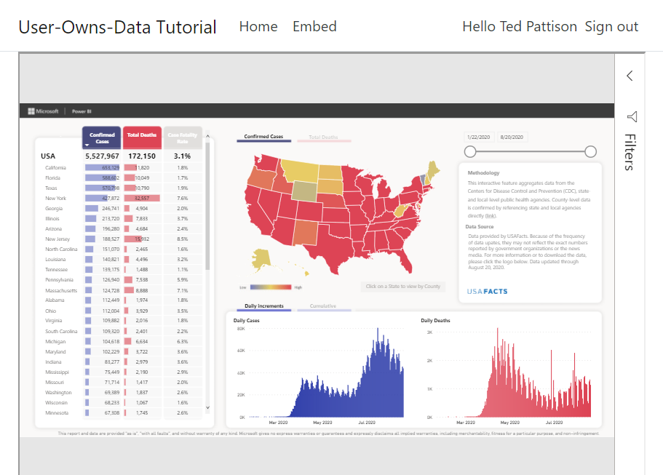
Dynamically Resizing the Embed Container

Slide 42
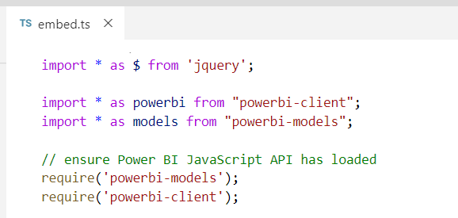
Exercise 5 Adding TypeScript/Webpack Support to a .NET Core Project
embed.ts
webpack
embed.js
jquery.js
Typescript Compiler
Powerbi.js

Slide 43


Adding Node.js Support for TypeScript Compilation

Slide 44


Running npm install

Slide 45


Running npm build

Slide 46

Updating UserOwnsData.csproj

Slide 47


Running dotnet build

Slide 48

Programming the PBI JS API using TypeScript

Slide 49


Exercise 6 Creating a View Model for App Workspaces

Slide 50

Creating the User Experience

Slide 51
Questions

